Slide 1
ControlNet: Adding Edge Conditioning for Enhanced Control with Unconditional Diffusion Model
Shaunak Mukherjee
ECE570 Fall 2024
Dec 06, 2024
My reimplemented code repository https://anonymous.4open.science/r/ControlNet-ECE570-D5C5

Slide 2
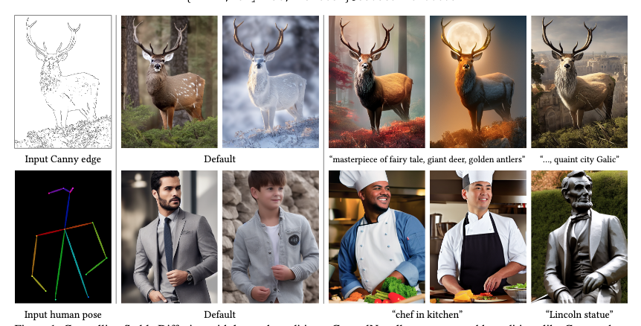
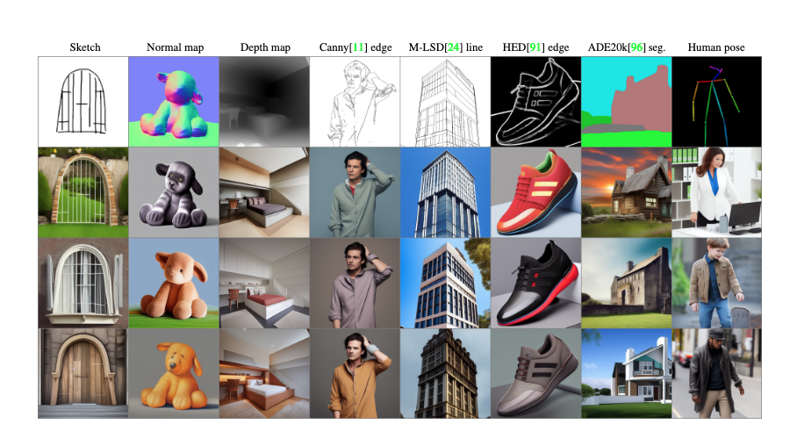
ControlNet: Introduction to the Original Work
ControlNet is a neural network model for controlling Stable Diffusion.
Adds one more spatial conditioning control in many different forms to a pretrained diffusion model
Text prompt + Input spatial control (e.g. canny edge)
A high-quality, detailed, and professional image or optional prompts can be used
Pre trained Diffusion Model
Zhang et al. ICCV 2023
Zhang et al. ICCV 2023

Slide 3
ControlNet: My Reimplementation on MNIST
Objective: Reimplementation of ControlNet using a custom diffusion model (UNet) using Mnist dataset to demonstrate the proof of concept. The key challenge addressed in my work is enhancing spatial control in a pretrained diffusion model with least computational resource.
Problem Statement: While current stable diffusion models are powerful, they struggle with fine-grained spatial control
Why not just use SD ?
Pre train SD model trained on 2B images (e.g. LAION-5B (public dataset) for high diversity and fidelity. Hefty computation cost
Train using dataset with condition and images (& text captioning) pairs – Choice of dataset is limited & smaller size
Fine tune SD on this smaller conditioning pair dataset risk of overfitting, catastrophic forgetting, low generation capability and low diversity
Pre trained Diffusion Model
Trained on 2B images
ControlNet spatial control
Controlled Diffusion Model (retains capabilities of pre trained model)

Slide 4
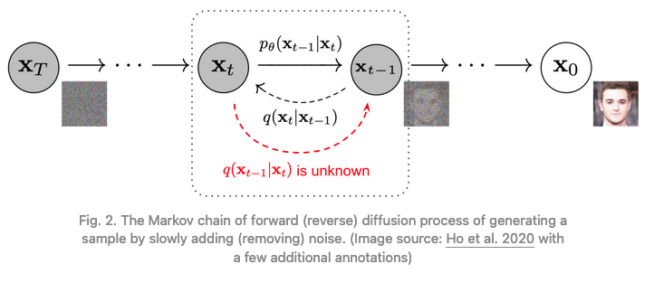
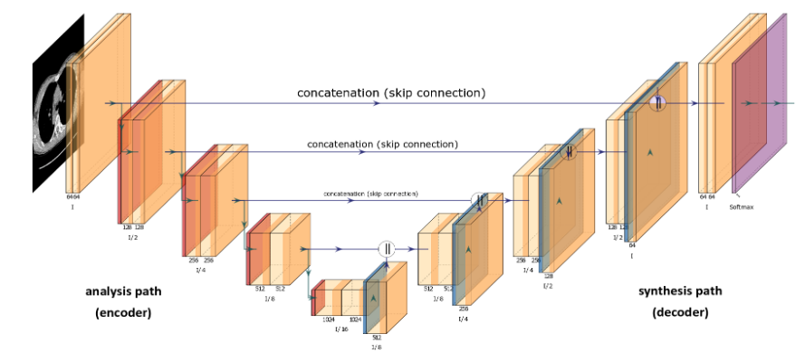
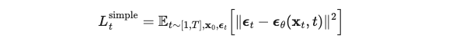
How Stable Diffusion Work
They define a markov chain of diffusion steps to slowly add random noise encode an image and then learn to reverse the diffusion process using noise predictor such as U-Net to construct desired data samples from the noise.
Forward diffusion- add gaussian noise of variance β_{t} to X_{t-1} to produce new latent variable X_{t} with q(X_{t}|X_{t-1})
Reserve diffusion- denoising, NN is trained to find parameters θ, to recreate sample from gaussian noise input from q(X_{t-1}|X_{t}) ,
Encoder blocks
(down sampler)
Decoder blocks
(up sampler)
U-Net example
Ho et al, NIPS, 2020
Mid blocks
Applied Computer Systems 25(1):43-50
https://lilianweng.github.io/posts/2021-07-11-diffusion-models/

Slide 5
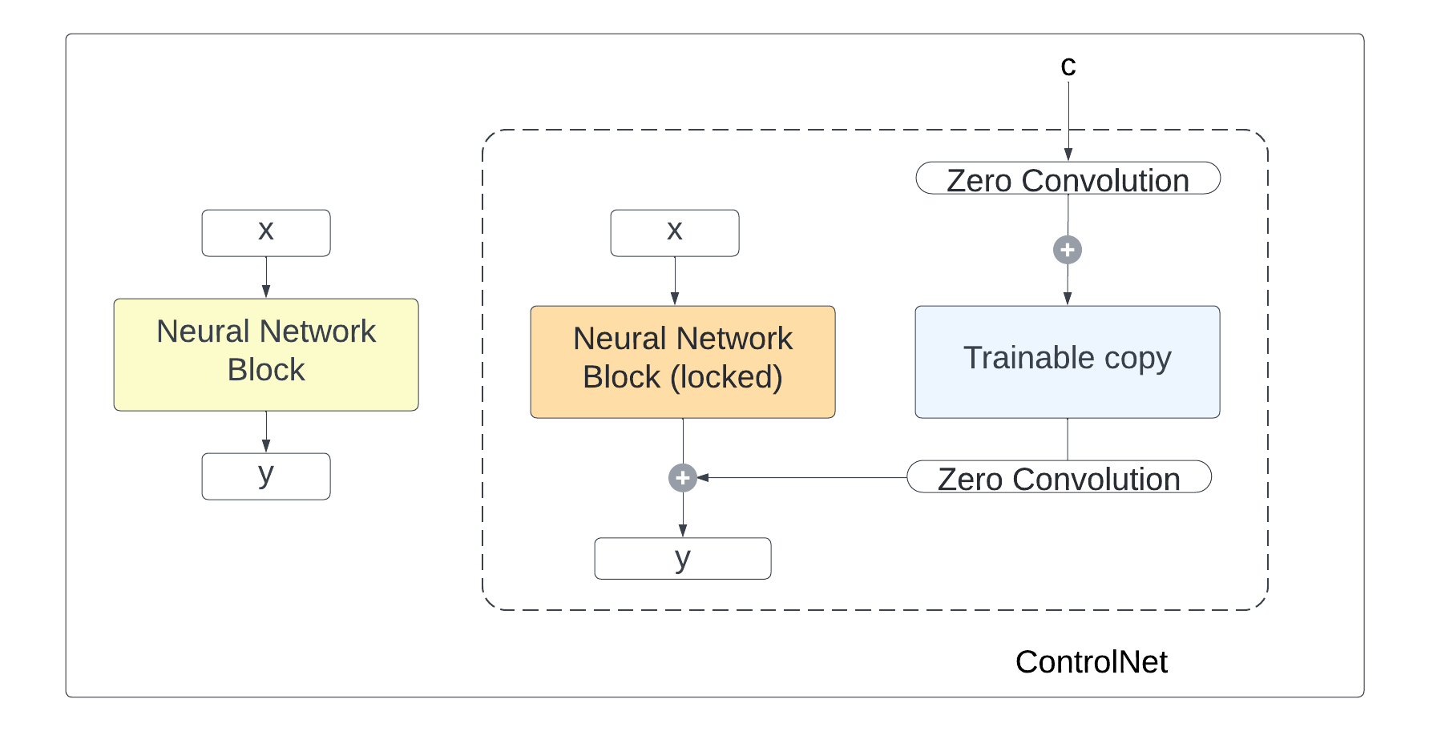
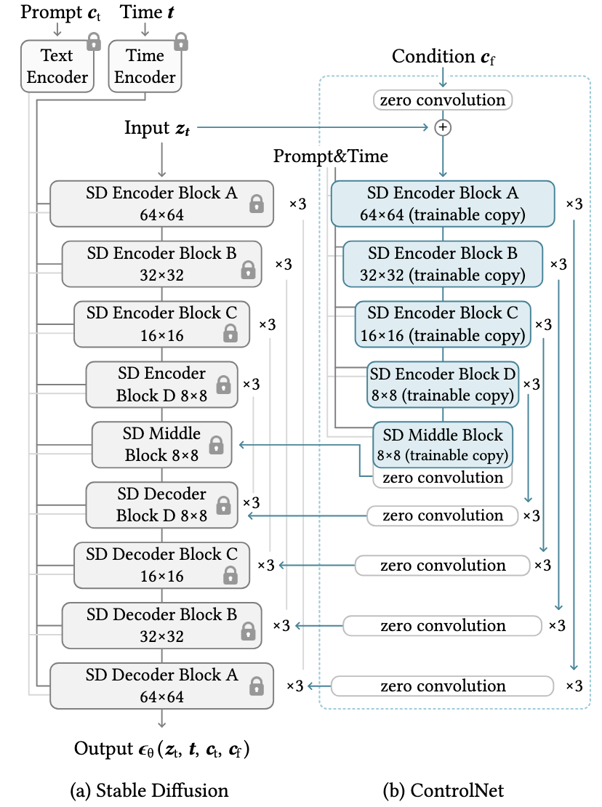
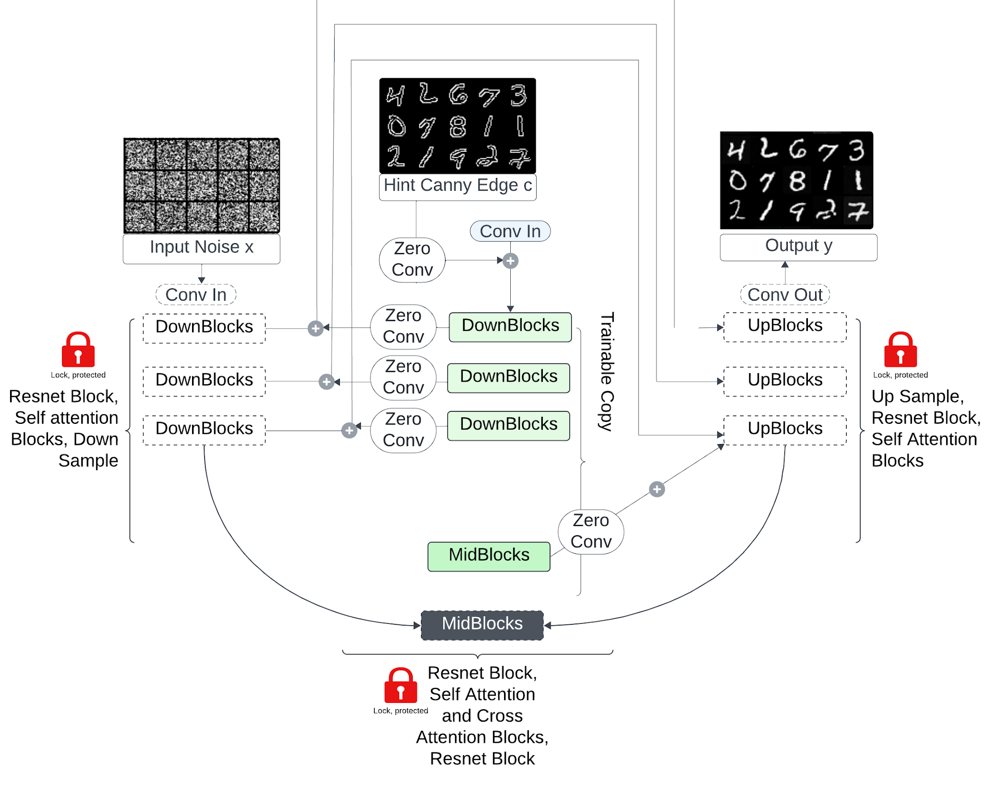
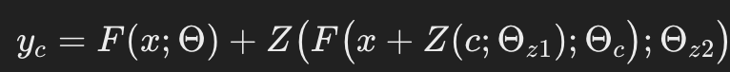
ControlNet: Methodology
Basic principle
Model Architecture
Reimplementation on MNIST with slight modification
My Model Arch: Unconditional DDPM, no CA layers, no text encoding
Input x+c
conditioning
Zhang et al. 2023 ICCV
Modified from Zhang et al. 2023 ICCV
Zero conv – 1x1 conv layer weights and biases initialized to 0, preserves the diffusion block from noise during start of training
Simple implementation without large compute resource using MNIST
Code- https://anonymous.4open.science/r/ControlNet-ECE570-D5C5

Slide 6
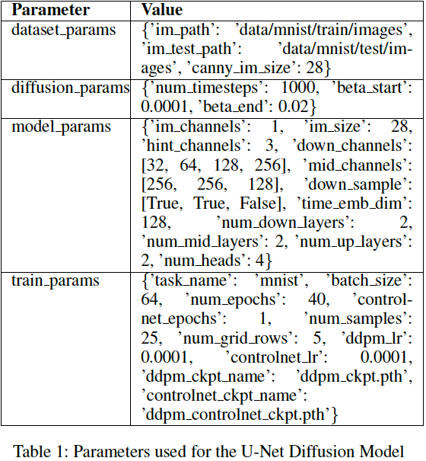
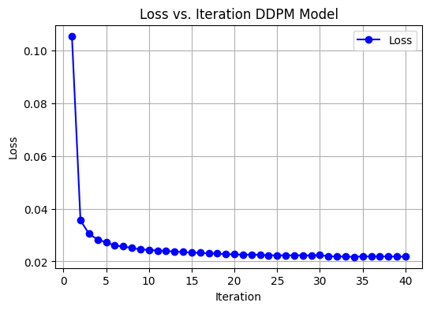
Methodology: Model parameter & Training
Implemented on MNIST image dataset 70,000 grayscale images of handwritten digits (0-9) with a resolution of 28x28 pixels.
It includes 60,000 training samples and 10,000 test samples.
The test and training label csv files were obtained from Kaggle.(www.kaggle.com/datasets/oddrationale/mnist-in-csv)

Slide 7
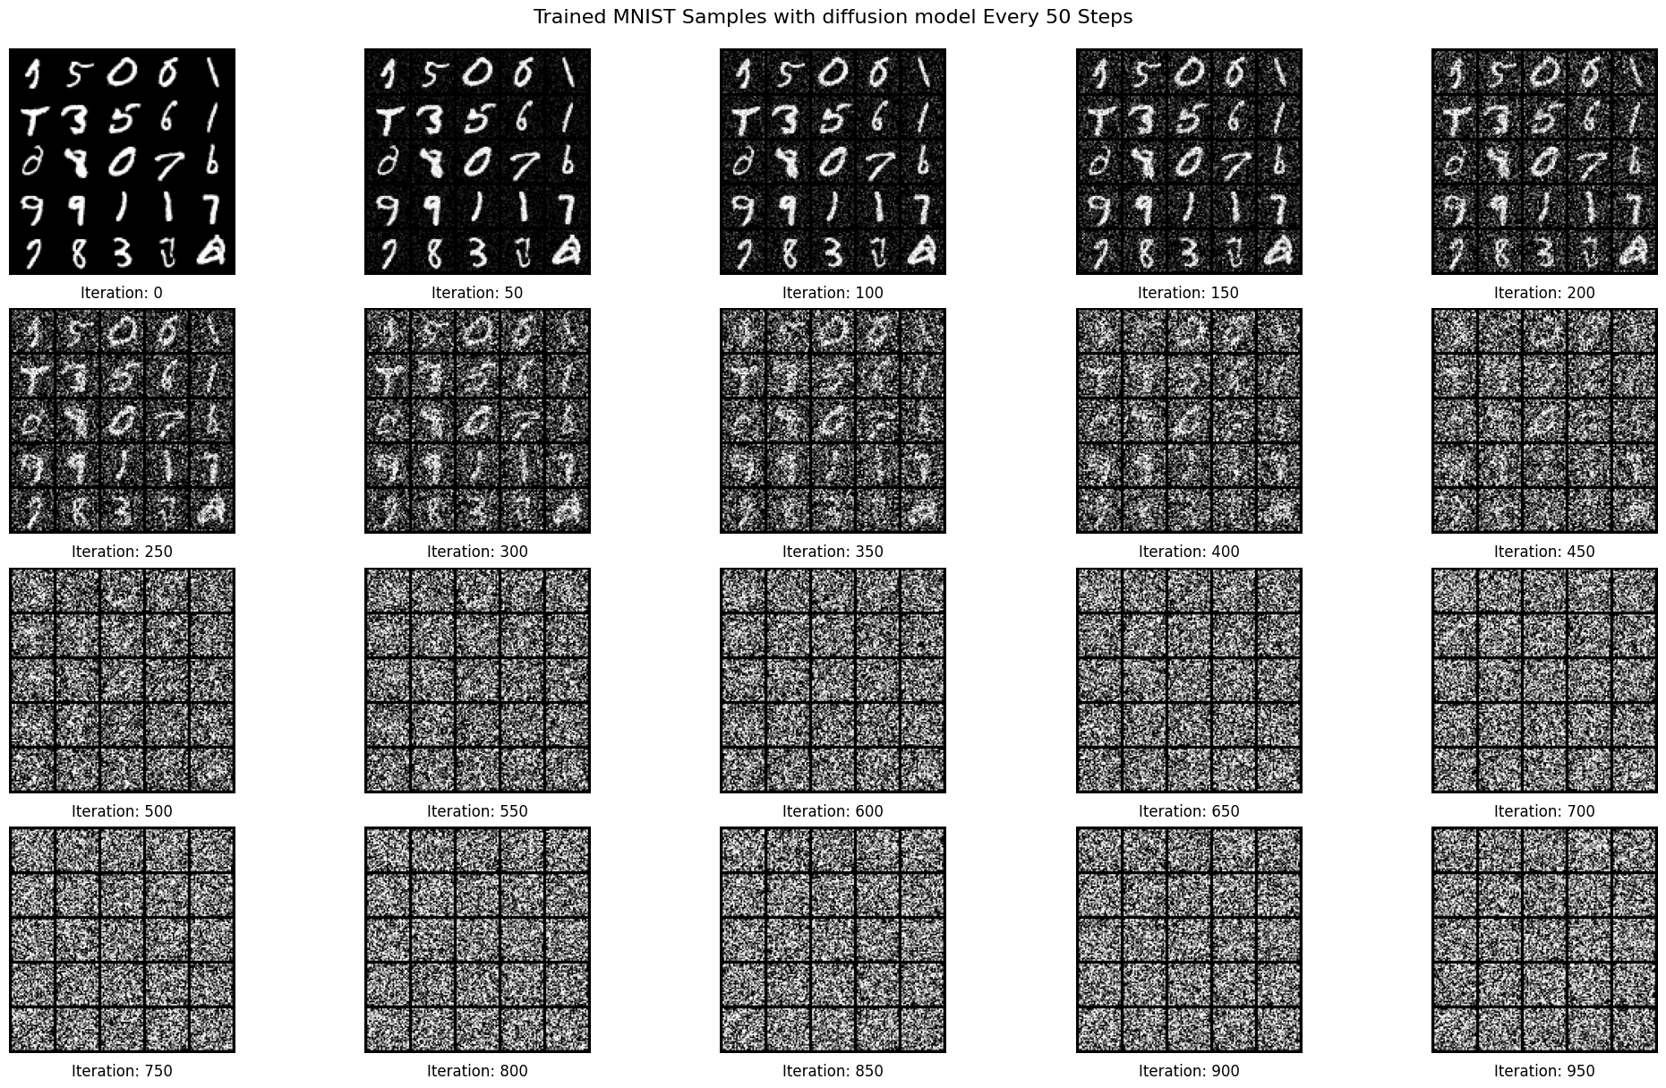
Inference Post Diffusion Model Training
Reverse diffusion process on the unconditional DDPM trained with MNIST. The model starts with a random noisy
image at iteration t = 1000 and progressively denoises it to recover a clear MNIST digit image at t = 0.
Notes:
Diffusion models work by gradually adding gaussian noise through a series of TT steps into the original image, a process known as diffusion

Slide 8
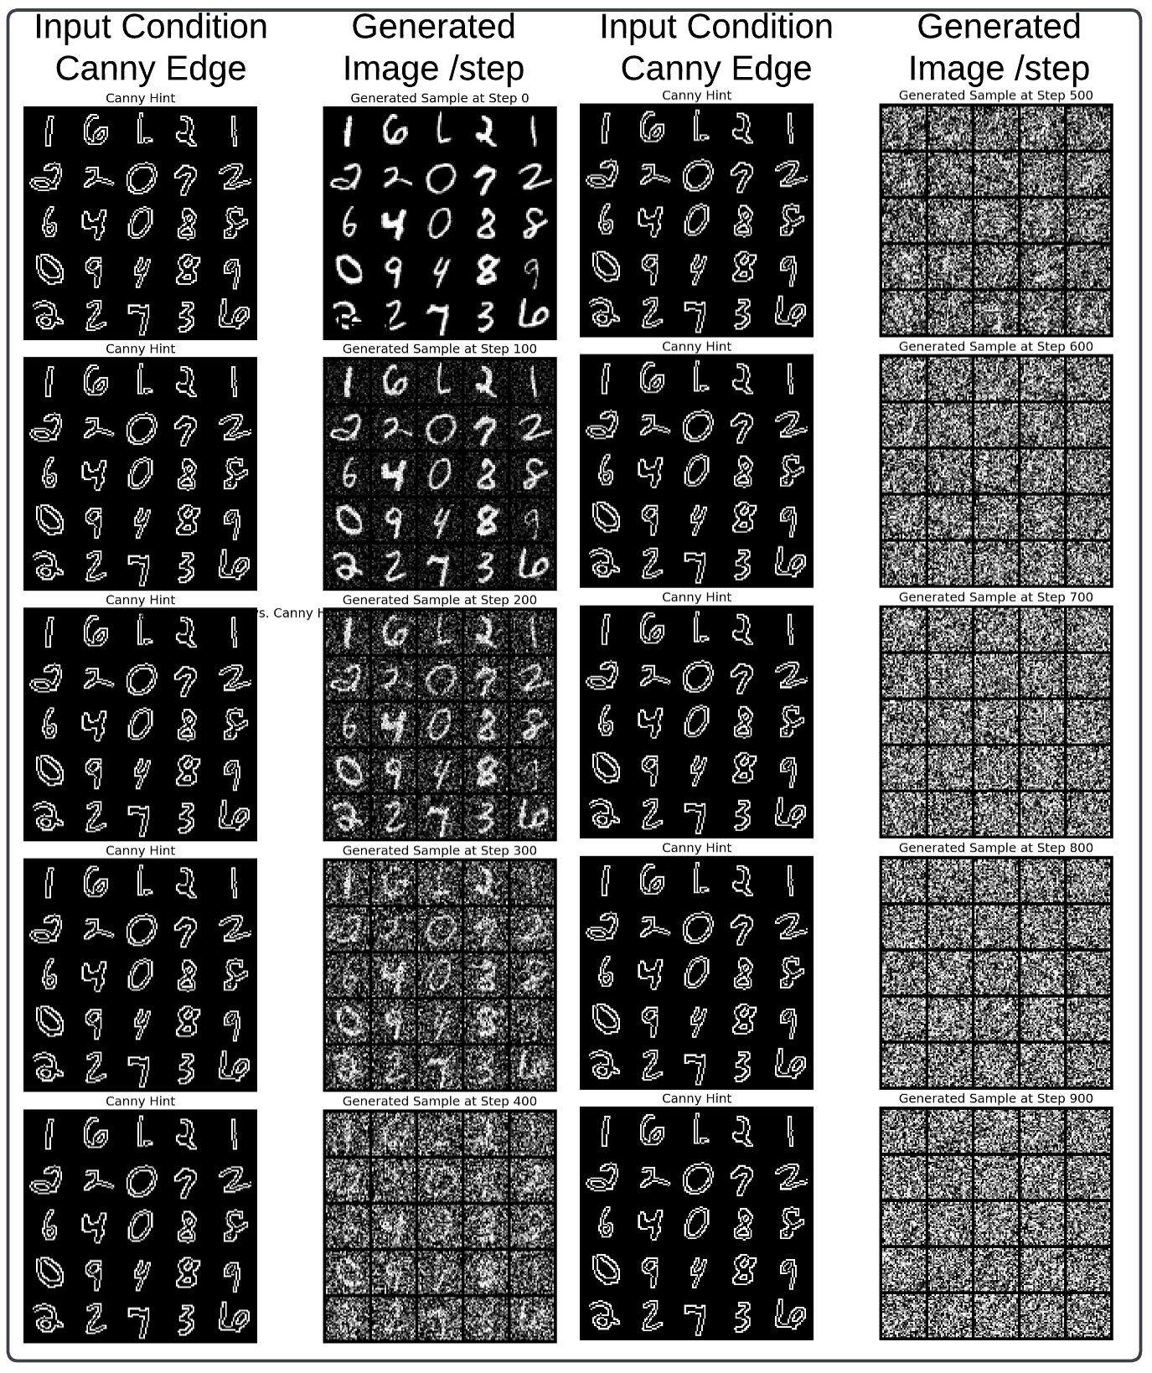
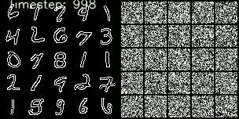
ControlNet Inference
Inference time evolution Video
Using hint block edge image, C-Net was able to fill the pixels within the handwritten digits. Hence conditioning control of C-Net is Demonstrated!

Slide 9
Summary and Future Outlook
Summary:
Demonstrated ControlNet on MNIST using Canny edge maps as hints for the diffusion model proving the effectiveness of ControlNet with much less compute resource.
Generated images compared with corresponding Canny edges at different timesteps.
Future Directions:
Add convolutional layers for artistic filters (e.g., edge detection, style transformations) or
Explore style-based filters inspired by style transfer techniques or example: Implement Impressionistic customization with Gaussian Blur and CV2 noise adjustments for texture and brushstroke effects.

